Slide 1
Data Rangers
Team 3600
By: Cameron, Mamuna, Juana, Nadia, Kevin, Haoliang

Slide 2
AGENDA
Business Problem
Methodology & Process
Analysis
Business Intelligence
Tech Stack
Team Roles

Slide 3
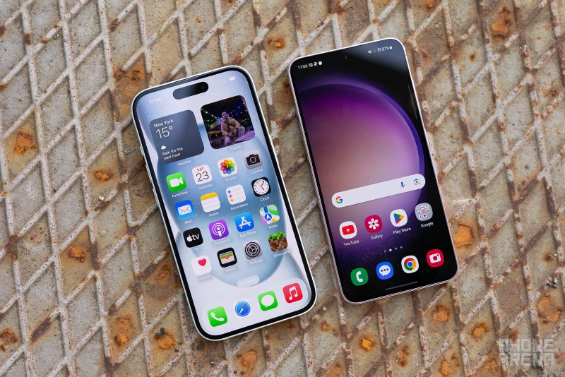
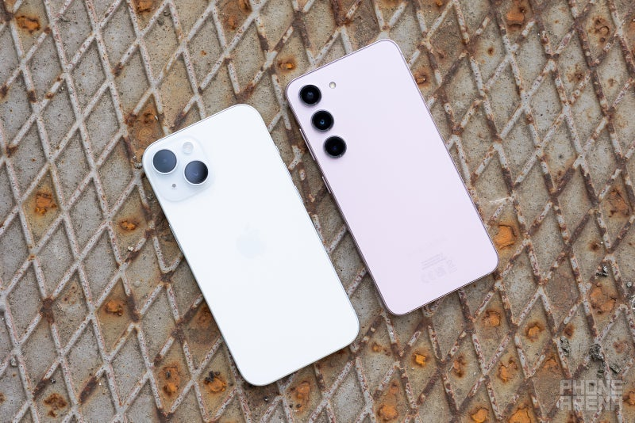
Business Problem
Which smartphone brand–Samsung or iPhone–shows long term consumer interest, making it a better investment opportunity?
iPhone 15 vs Galaxy S23: which base model is better?

Slide 4
Business Problem
How is the question relevant?:
Consumer interest directly impact sales and brand loyalty
Investors can use trend data to predict potential stock performance and product success
Understanding brand popularity helps businesses allocate marketing budgets effectively
Apple and Samsung are market leaders in the smartphone industry, launching flagship devices that compete for consumer attention yearly

Slide 5
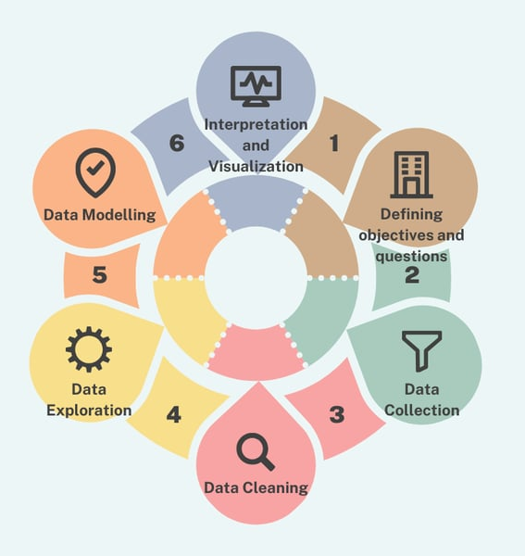
Methodology & Process
Data Collection:
Google Trends API for historical search interest data using Pytrends.
Twitter API and Reddit API for sentiment analysis.
Data Cleaning and Transformation:
Clean data using Pandas.
Handle missing/incorrect data and outliers.
Transform data types as needed.
Exploratory Data Analysis (EDA):
Visualize trends using Matplotlib.
Modeling and Analysis:
Perform time series analysis using ARIMA or Prophet.
Apply Sentiment Analysis to classify positive, negative, or neutral opinions.
Visualization:
Build an interactive BI Dashboard using Tableau

Slide 6
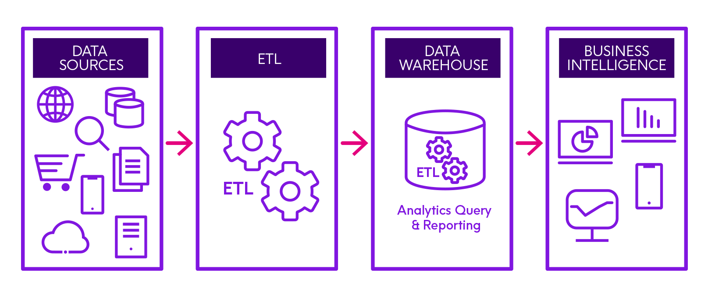


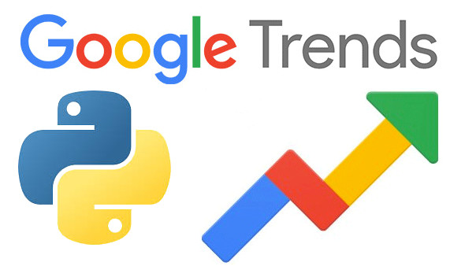



Methodology
Potential Data Sources
Google Trends API (Pytrends)
Social Media Scraping
Twitter/X API
Reddit API
ETL Process
Extract:
Use pytrends to collect Google search trends data
Transform:
Clean the dataset, appropriately handling missing data
Load:
Store the cleaned data in a pandas DataFrame for (future) analysis

Slide 7
Analysis & Business Intelligence
Analysis Goals
Compare long-term popularity for iPhone vs. Samsung
Identify seasonal trends (launch spikes, or impact or holiday sales)
Identify regional interests (which countries favor which brand more?)
Visualization Strategy
Time-Series Line Chart (popularity trends over time)
Geographical Heatmap (display search interests by region)
Bar charts (compare peak search volume at product launches)

Slide 8

Data Collection
The data was collected using different APIs.
Data collected using the get request to the Pytrends API, Twitter API, and Reddit API
Next, we decode the response content into json format using .json() for Reddit’s and Twitter’s API response contents.
Data cleaning is performed, checking for missing values or removing irrelevant data.
The objective was to extract the trends and datas regarding Samsung and iPhone’s popularity
Notes:
Loop thru api responses to get the data and turn into dataframe. Pytrends data is returned in a tabular format so no need to loop thru.

Slide 9
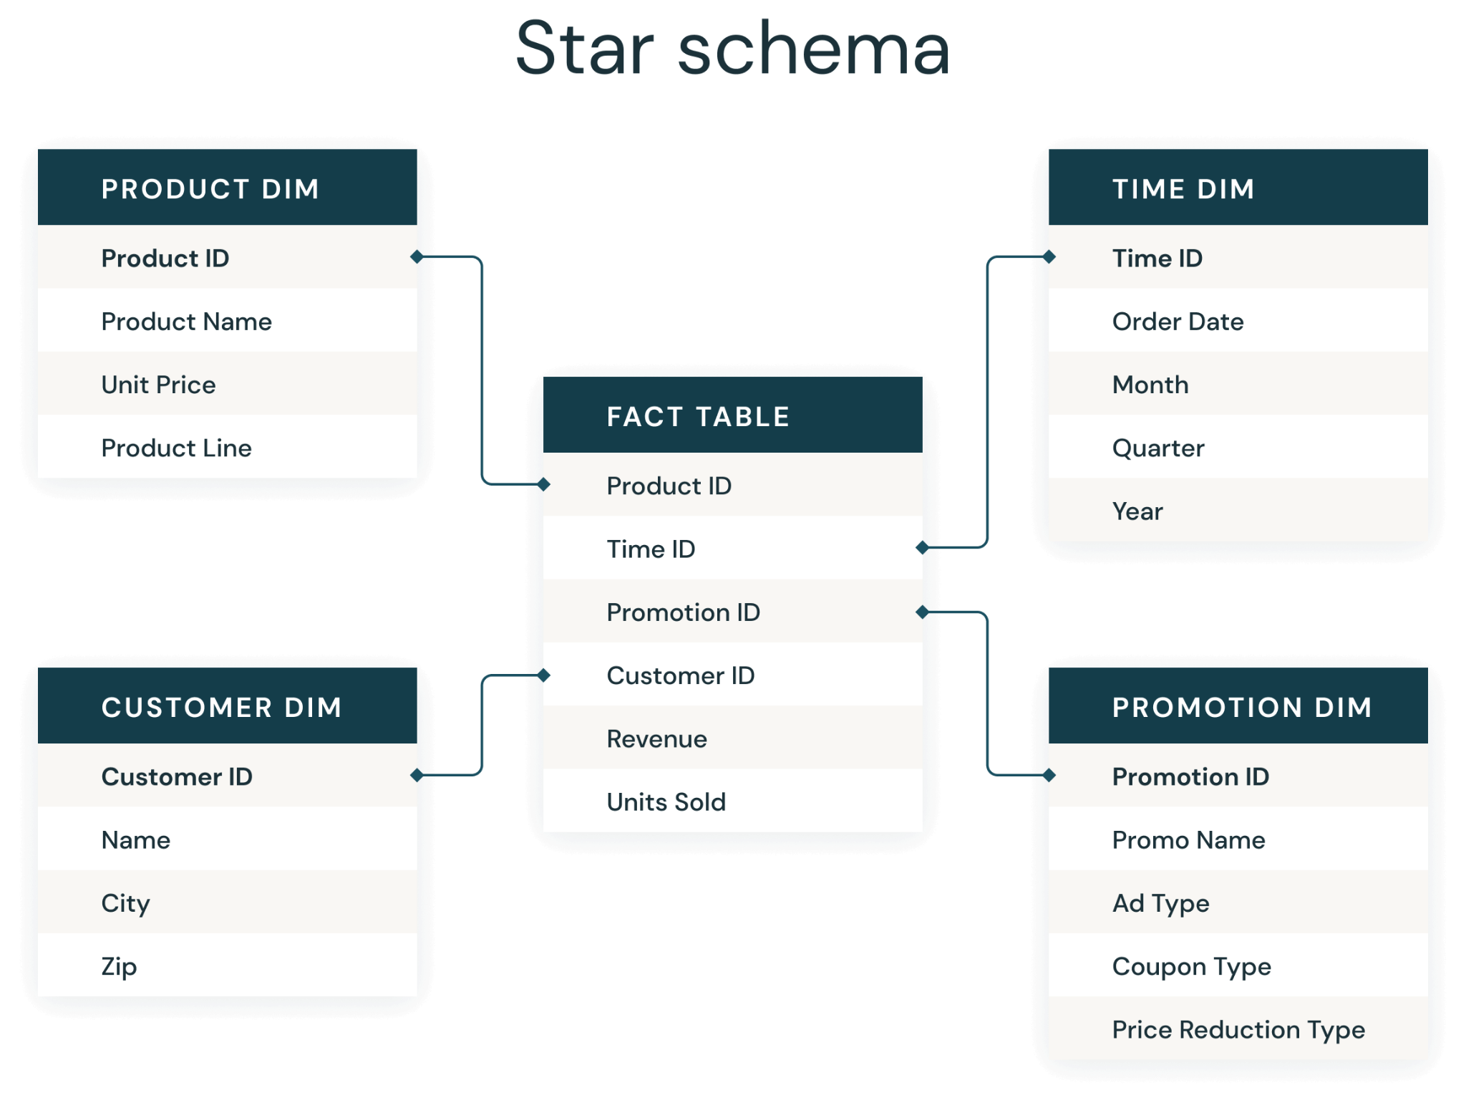
Data Model: Star Schema
Why This Model Works Best
Efficient Querying: Optimized for large-scale analysis using BI tools.
Data Aggregation: Easily compare brands by region, platform, or time.
Trend Analysis: Perform time-series analysis for long-term interest.
Sentiment Insights: Evaluate public perception using sentiment analysis.
Investment Support: Visualize key patterns for better decisions.

Slide 10
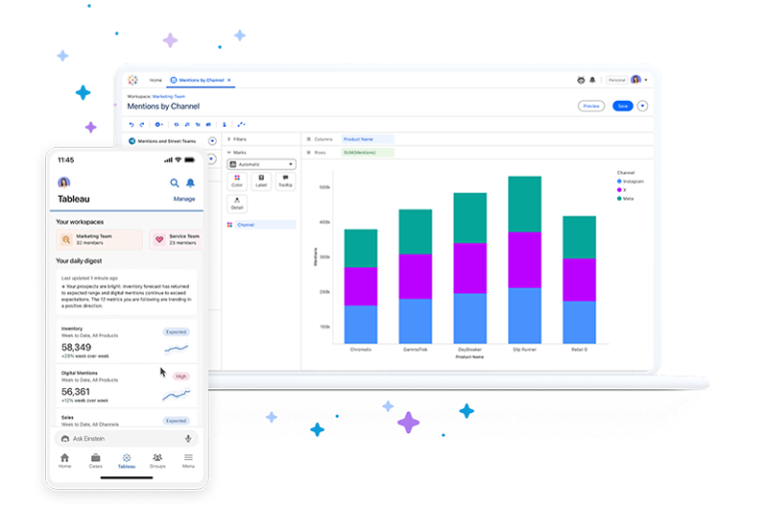
Business Intelligence Dashboard
Selected BI Tool: Tableau
Relatively beginner friendly
Supports dynamic filtering, allowing us to view trends by country
Integrates well with our Python processing

Slide 11



Tech Stack
Social Media APIs
Google Trends API (Pytrends)
Twitter/X API
Reddit API
Python
Pytrends API
pandas
NumPy
matplotlib
Seaborn
Tableau
Git for version control
(IDE like VS Code or smth)

Slide 12
Team Roles
Cameron
Mamuna
Juana
Nadia
Kevin
Haoliang

Slide 13
Questions?

